Slide 2
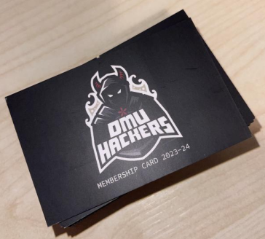

Announcements
This is the LAST free session -
please buy your memberships!
Come see us to claim your Firebug card
CTF club
Halloween next week
Notes:
We are DMU Hackers

Slide 3
Cyber First Cyber First Cyber First Cyber First Cyber First Cyber First Cyber First Cyber First Cyber First Cyber First Cyber First Cyber First Cyber First Cyber First Cyber First Cyber First Cyber First Cyber First Cyber First Cyber First Cyber First Cyber First Cyber First Cyber First Cyber First Cyber First Cyber First Cyber First Cyber First Cyber First Cyber First Cyber First Cyber First Cyber First Cyber First Cyber First Cyber First Cyber First Cyber First Cyber First Cyber First Cyber First Cyber First Cyber First Cyber First Cyber First Cyber First Cyber First Cyber First Cyber First Cyber First Cyber First Cyber First Cyber First Cyber First Cyber First Cyber First Cyber First Cyber First Cyber First Cyber First Cyber First Cyber First Cyber First Cyber First Cyber First Cyber First Cyber First Cyber First Cyber First Cyber First Cyber First Cyber First Cyber First Cyber First Cyber First Cyber First Cyber First Cyber First Cyber First Cyber First Cyber First Cyber First Cyber First Cyber First Cyber First Cyber First Cyber First Cyber First Cyber First Cyber First Cyber First Cyber First Cyber First Cyber First Cyber First Cyber First Cyber First Cyber First Cyber First Cyber First Cyber First Cyber First Cyber First Cyber First Cyber First Cyber First Cyber First Cyber First Cyber First Cyber First Cyber First Cyber First Cyber First Cyber First Cyber First Cyber First Cyber First Cyber First Cyber First Cyber First Cyber First Cyber First Cyber First Cyber First Cyber First Cyber First Cyber First Cyber First Cyber First Cyber First Cyber First Cyber First Cyber First Cyber First Cyber First Cyber First Cyber First Cyber First Cyber First Cyber First Cyber First Cyber First Cyber First Cyber First Cyber First Cyber First Cyber First Cyber First Cyber First Cyber First Cyber First Cyber First Cyber First Cyber First Cyber First Cyber First Cyber First Cyber First Cyber First Cyber First Cyber First Cyber First Cyber First Cyber First Cyber First Cyber First Cyber First Cyber First Cyber First Cyber First Cyber First Cyber First Cyber First Cyber First Cyber First Cyber First Cyber First Cyber First Cyber First Cyber First Cyber First Cyber First Cyber First Cyber First Cyber First Cyber First Cyber First Cyber First Cyber First Cyber First Cyber First Cyber First Cyber First Cyber First Cyber First Cyber First Cyber First Cyber First Cyber First Cyber First Cyber First Cyber First Cyber First Cyber First Cyber First Cyber First Cyber First Cyber First Cyber First Cyber First Cyber First Cyber First Cyber First Cyber First Cyber First Cyber First Cyber First Cyber First Cyber First Cyber First Cyber First Cyber First Cyber First Cyber First Cyber First Cyber First Cyber First Cyber First Cyber First Cyber First Cyber First Cyber First Cyber First Cyber First Cyber First Cyber First Cyber First Cyber First Cyber First Cyber First Cyber First Cyber First Cyber First Cyber First Cyber First Cyber First Cyber First Cyber First Cyber First Cyber First Cyber First Cyber First Cyber First Cyber First Cyber First Cyber First Cyber First Cyber First Cyber First Cyber First Cyber First Cyber First Cyber First Cyber First Cyber First Cyber First Cyber First Cyber First Cyber First Cyber First Cyber First Cyber First Cyber First Cyber First Cyber First Cyber First Cyber First Cyber First Cyber First Cyber First Cyber First Cyber First Cyber First Cyber First Cyber First Cyber First Cyber First Cyber First Cyber First Cyber First Cyber First Cyber First Cyber First Cyber First Cyber First Cyber First Cyber First Cyber First Cyber First Cyber First Cyber First Cyber First Cyber First Cyber First Cyber First Cyber First Cyber First Cyber First Cyber First Cyber First Cyber First Cyber First Cyber First Cyber First Cyber First Cyber First Cyber First Cyber First Cyber First Cyber First Cyber First Cyber First Cyber First Cyber First Cyber First Cyber First Cyber First Cyber First Cyber First Cyber First Cyber First Cyber First Cyber First Cyber First Cyber First Cyber First Cyber First Cyber First Cyber First Cyber First Cyber First Cyber First Cyber First Cyber First Cyber First Cyber First Cyber First Cyber First Cyber First Cyber First Cyber First Cyber First Cyber First Cyber First Cyber First Cyber First Cyber First Cyber First Cyber First Cyber First Cyber First Cyber First Cyber First Cyber First Cyber First Cyber First Cyber First Cyber First Cyber First Cyber First Cyber First Cyber First Cyber First Cyber First Cyber First Cyber First Cyber First Cyber First Cyber First Cyber First Cyber First Cyber First Cyber First Cyber First Cyber First Cyber First Cyber First Cyber First Cyber First Cyber First Cyber First Cyber First Cyber First Cyber First Cyber First Cyber First Cyber First Cyber First Cyber First Cyber First Cyber First Cyber First Cyber First Cyber First Cyber First Cyber First Cyber First Cyber First Cyber First Cyber First Cyber First Cyber First Cyber First Cyber First Cyber First Cyber First Cyber First Cyber First Cyber First Cyber First Cyber First Cyber First Cyber First Cyber First Cyber First Cyber First Cyber First Cyber First Cyber First Cyber First Cyber First Cyber First Cyber First Cyber First Cyber First Cyber First Cyber First Cyber First Cyber First Cyber First Cyber First Cyber First Cyber First Cyber First Cyber First Cyber First Cyber First Cyber FirstCyber
CyberFirst
cyberfirst@dmu.ac.uk or sarah.hd@dmu.ac.uk
Notes:
We are DMU Hackers

Slide 4
CTF Club
wing wednesdays
wing wednesdays
wing wednesdays
wing wednesdays
WHAT IS CTF CLUB????
Meet up every wednesday from 2pm
Starts next week - 25/10/23
Soar Point
Collaboratively do THM boxes / CTFs / OSINT challenges
No experience needed!
2pm Wednesday 25th October
@ Soar Point
Notes:
We are DMU Hackers

Slide 5

TryHackMe Premium
If you’re interested in buying THM Premium, please use our referral code - will save you $5
It’s pretty worth it, use your student email (.ac.uk) and it’s discounted by 20% to £10 a month
https://tryhackme.com/signup?referrer=612e9d2c35ba4b005a24feee
Notes:
We are DMU Hackers

Slide 6





Halloween Next Week
Spooky session
FANCY DRESS IS MANDATORY (unless you really don’t want to…)
Prepare to be scared!
25th October - NEXT WEEK
Notes:
We are DMU Hackers

Slide 7

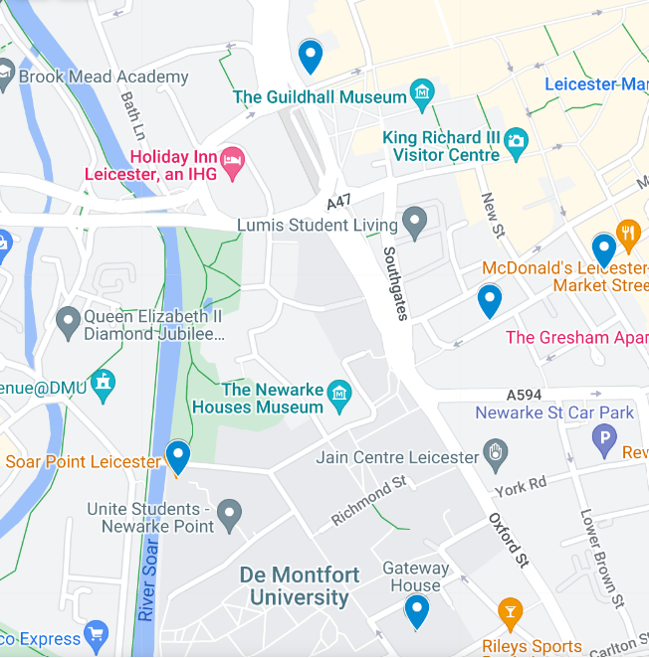


Social

Slide 8
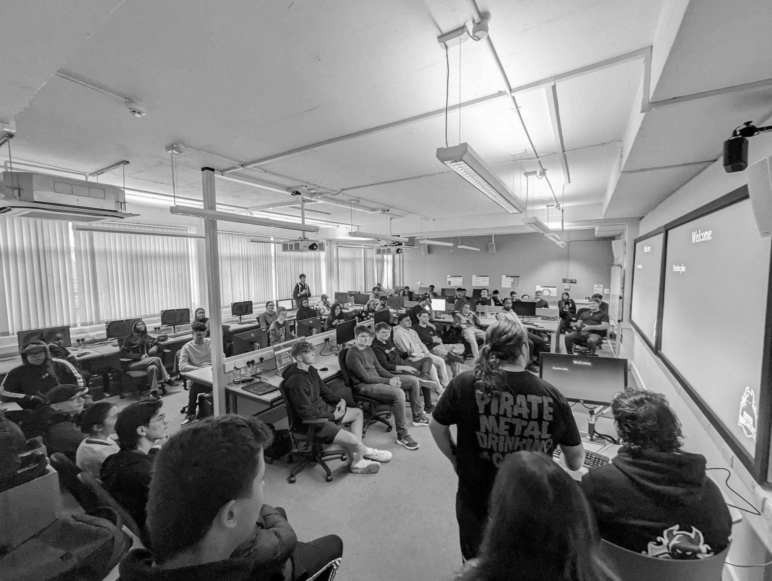


hackers.dmu
@dmuhackers
Introduction to OSINT

Slide 9



Don’t do creepy shit

Slide 10


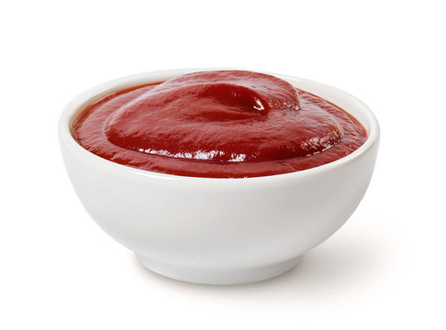
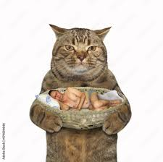
O
OSINT
S
INT
Open
Source
INTelligence
Notes:
We are DMU Hackers

Slide 11
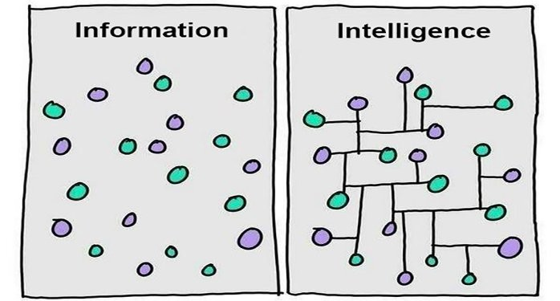
What is OSINT?
The collection and analysis of openly available data
Information vs Intelligence - ?
Information is raw, unprocessed data
Intelligence is processed information!
Notes:
We are DMU Hackers

Slide 12
What is it used for?
Corporate security
Background checks on new hires
Police investigation/counter terrorism
Threat Hunting/Research
Pentesting
Vetting
To socially engineer people…
Notes:
We are DMU Hackers

Slide 13






Some Areas of OSINT
Domain & IP Investigation
News + Media
Command-Line Tools
Image Analysis
Geolocation
Dark Web
Social Media Investigation
Reverse Image Search
Notes:
We are DMU Hackers

Slide 14

Google Dorking (aka ‘Google Hacking’)
Basically being clever with how you Google 🤓🤓🤓
Also useful for assignments/job/placement searching
Use symbols and keywords for precise searching
Use Case | Operator | Example Usage
Searching Within a Specific Website | site: | site:dmuhackers.com orlin
Finding Specific File Types | filetype: | filetype:pdf developed vetting uk
Discard pages which mention a certain word | - | Cyber jobs -trainee
Search for an exact result | “” | Cyber Security “placement”
Searching for Specific Text on a Web Page | intext: | intext:geolocation
Notes:
We are DMU Hackers

Slide 15
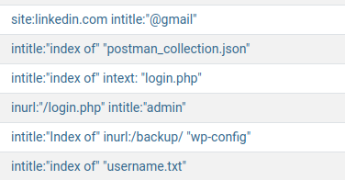
Google Dorking (aka ‘Google Hacking’)
More specifically for pentesters/bug bounty chasers, there’s a whole list of searches you can use:
https://www.exploit-db.com/google-hacking-database
Notes:
We are DMU Hackers

Slide 16
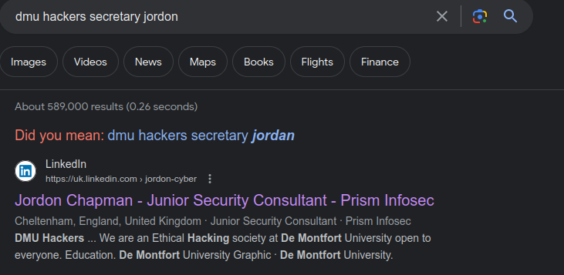
Social Media Investigations
A lot of people overshare way too much online - this works in our favour!
Especially if profiles are public!!
If you have a name, a great avenue to go down
‘DMU Hackers secretary Jordon’
Notes:
We are DMU Hackers

Slide 17
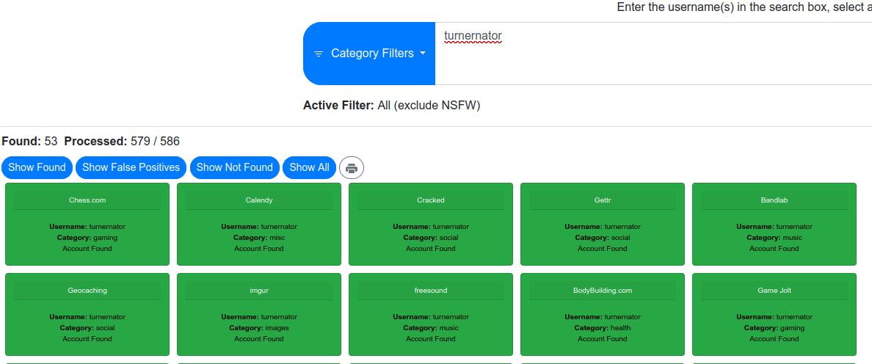
Social Media Investigations
A great tool for finding the services a given username has signed up to: https://whatsmyname.app
Notes:
We are DMU Hackers

Slide 18
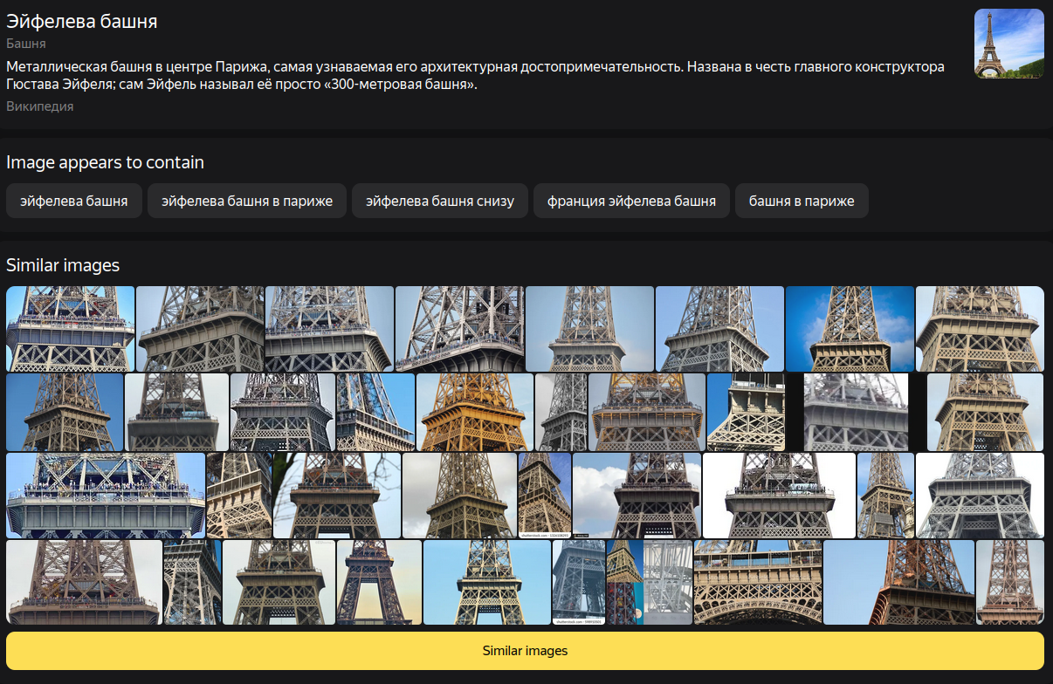

Image Analysis
Reverse image searching - great for landmarks, photos that might have been taken by others
Yandex >>>>>>>>>>>>>>>> Google Images, but always worth trying one if you don’t get results from the other
Google Lens - AI Powered
Notes:
We are DMU Hackers

Slide 19
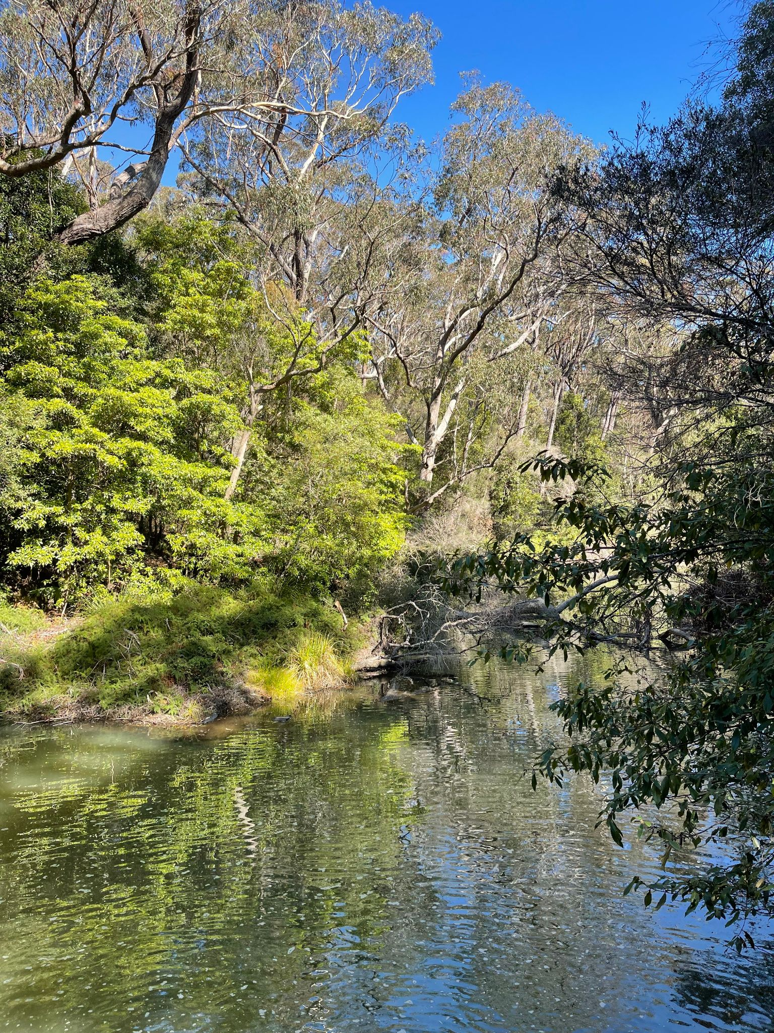
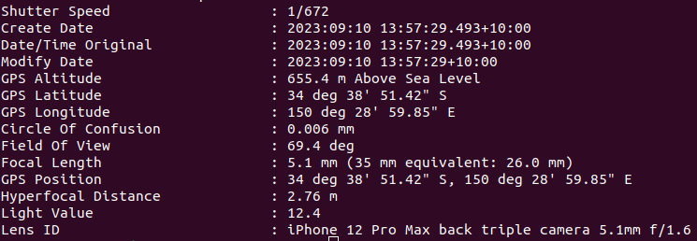
Image Analysis
EXIF - Image metadata
Most social media sites ‘strip’ this now, but a good shout especially for CTFs or websites
Image coordinates, type of camera, all sorts!
Notes:
We are DMU Hackers

Slide 20

Geolocation
Working out where in the world a photo was taken
Google Earth/Maps/Street View, Land Registry, Snapchat/Instagram, Yandex - possibilities are endless
Some things to think about:
Signs/Shop Names - can you google them? Can you reverse image search?
What side of the road are people driving on?
Anything that looks particularly unique?
Any kind of blurry text - search all possibilities, ie ikarvs, ikarus
Where did the image come from? Is this in itself a clue???
Never assume - confirm suspicions with proper evidence/another viewpoint
https://www.osintcurio.us/2021/04/06/ten-minute-tip-image-geolocation-part-2/
https://medium.com/quiztime/how-to-tell-the-geolocation-of-places-based-on-old-sources-using-osint-a-case-study-e44e0faed388
Notes:
We are DMU Hackers

Slide 21
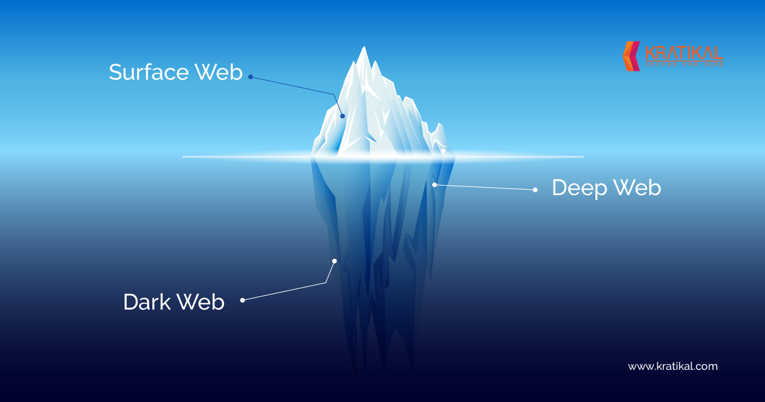
Dark Web
Most obvious use for this is cybercrime investigations
In corporate world - dark web monitoring - checking for breaches
Notes:
We are DMU Hackers

Slide 22
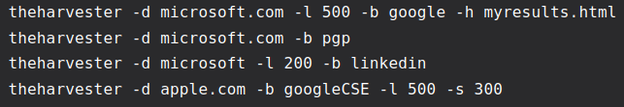
OSINT Tools
A HUGE AMOUNT of tools on GitHub - have a play with some!
Some of the more well-known ones:
TheHarvester - finds emails, subdomains and more from a given domain
Maltego - link analysis
VirusTotal - file/URL checking
Spiderfoot - similar to TheHarvester but on a
larger scale
Notes:
We are DMU Hackers

Slide 23

Today’s Task…
c
Can be found on the DMU Hackers GitHub under weekly_sessions\2023-2024\week_03\Tasks

Slide 24
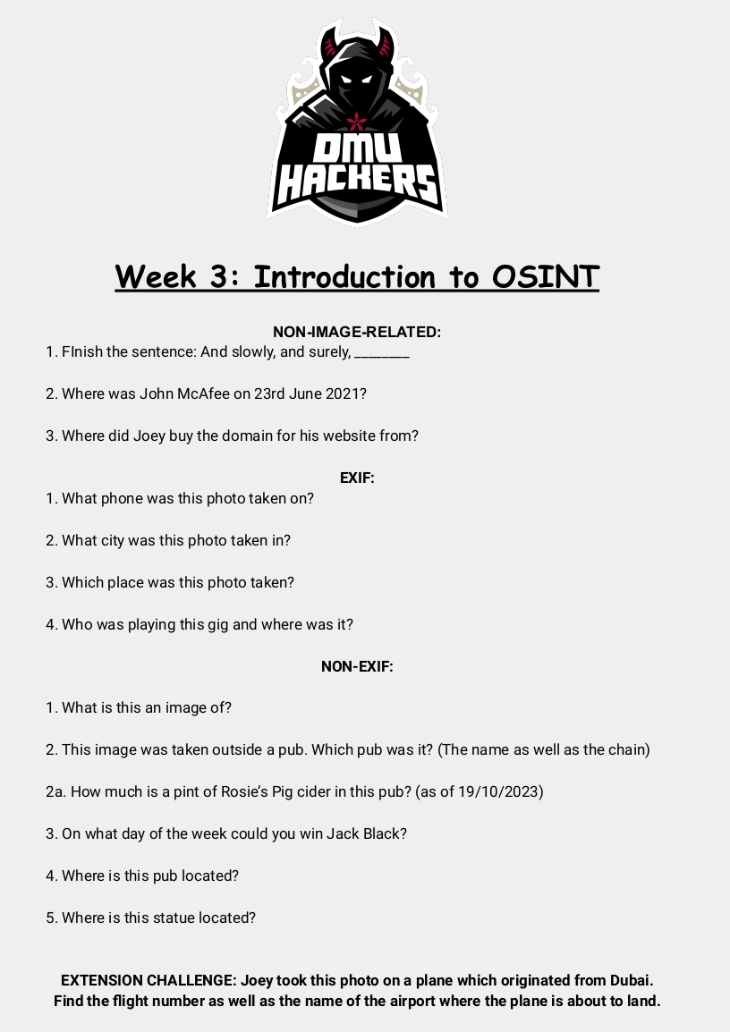
OSINT Challenges:
https://github.com/DMUHackers/weekly_sessions/tree/master/2023-2024/week_03/tasks
c

Slide 25
c
Answers and/or solutions are located inside the tasks folder

Slide 26
Resources
exiftool
whatsmyname.app username OSINT tool
List of 'juicy' google search terms
TryHackMe referral link
OSINT Cheatsheet
Geolocation - Example 1
Geolocation - Example 2
Notes:
We are DMU Hackers

